Slide 1

AKS Office Hours
Kendall Roden
Cloud Native Technical Specialist
Kendal Roden
Cloud Native Technical Specialist
Dave Strebel
Cloud Native Technical Specialist

Slide 2

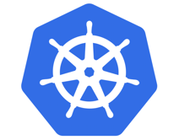

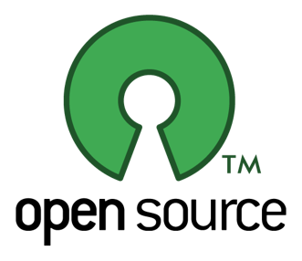
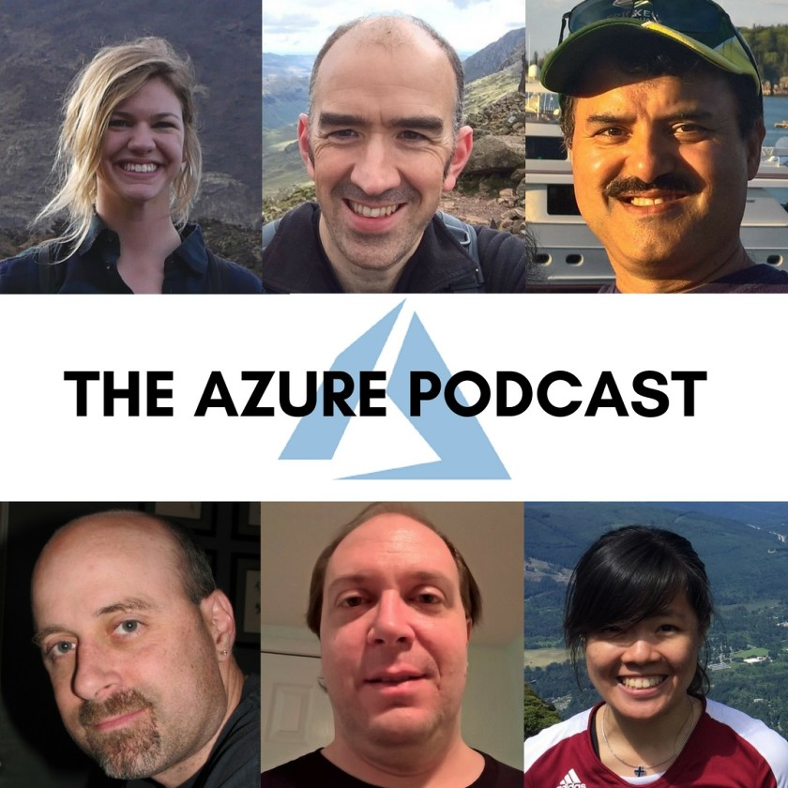

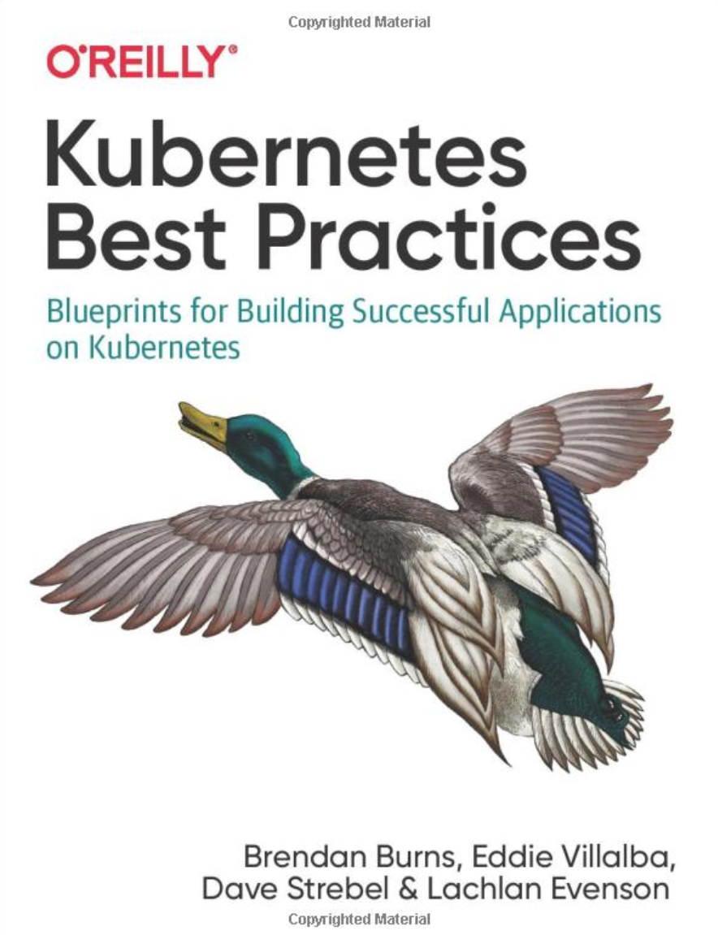
Who are we?
@kendallroden​
@dave_strebel​

Slide 3
Why AKS Office Hours?
Provide AKS customers with updates pertaining to AKS and the Cloud Native Ecosystem
Host a short talk and/or demo on Cloud Native technologies related to Kubernetes and AKS
Collect feedback from customers on issues, blockers, use cases, and questions related to AKS

Slide 4
What to expect
Call agenda
10 minutes: Welcome, followed by AKS and ecosystem updates
40 minutes: Dapr on AKS with Kendall Roden
10 minutes: “Ask us anything” and customer feedback discussion
Keep in mind
Office hours are hosted primarily by the GBB team, with the support of the PG
Recordings and content will be available post-call on GitHub, barring any technical difficulties
Contact us with thoughts, ideas or questions (aksofficehours@microsoft.com)

Slide 5
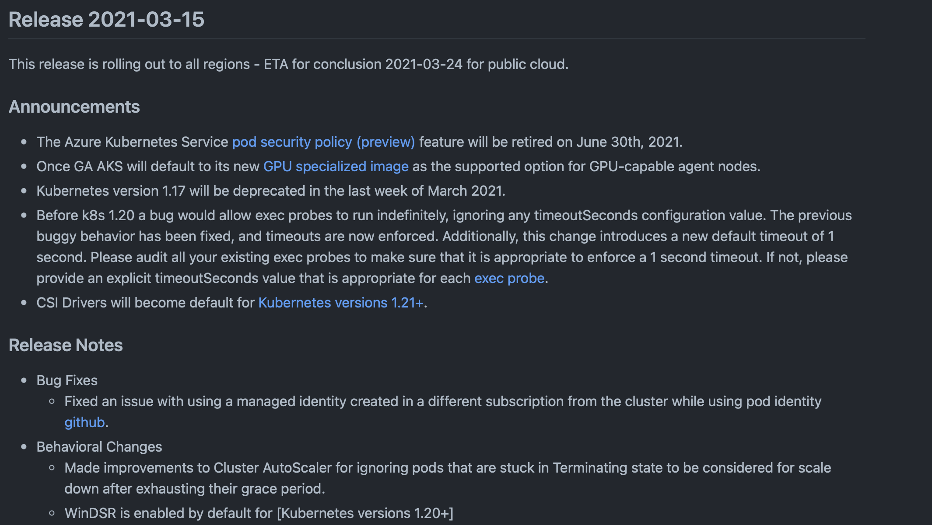
AKS Release Notes
Kubernetes version 1.17 will be deprecated in the last week of March 2021
Managed Identities for Pod Identity increased from 50 to 200
Timeout on exec probes
Windows container feedback GitHub
Notes:
Key points:
1.20 out in preview! Deprecation: https://docs.microsoft.com/en-us/azure/aks/supported-kubernetes-versions#aks-kubernetes-release-calendar
1.20 overview: https://kubernetes.io/blog/2020/12/08/kubernetes-1-20-release-announcement/
Starting in version 1.20, timeouts on exec probes are honored, and default to 1 second if unspecified. If you have Pods using exec probes, ensure that they can easily complete in 1 second or explicitly set an appropriate timeout. For more information, see ConfigureProbes.

Slide 6
Ignite AKS Updates
Generally Available:
Conditional Access
Public IP per node
Arc for K8s
App Gateway Ingress Controller add-on
Just in Time Access Support
Confidential computing nodes
Custom Weblogic containers
Persistent Volume Monitoring
Public Preview:
Calico on Windows Server
Planned Maintenance window
Dynamic IP Allocation
Kubenet Support for Pod Identity
…and more!
Notes:
AKS Ignite Updates:
GA for Conditional Access (MFA): https://azure.microsoft.com/en-us/updates/general-availability-conditional-access-feature-integration-with-aks/
GA Public IP per node - direct access to node not through a LB (for low latency scenarios): https://docs.microsoft.com/en-us/azure/aks/use-multiple-node-pools#assign-a-public-ip-per-node-for-your-node-pools-preview
GA Arc for K8s: also includes Azure Arc enabled ML https://azure.microsoft.com/en-us/blog/innovate-across-hybrid-and-multicloud-with-new-azure-arc-capabilities/
GA AGIC add on - create or attach: https://azure.microsoft.com/en-ca/updates/general-availability-app-gateway-ingress-controller-addon-for-aks/
GA Just in Time Access rules for tasks with elevated permissions: https://azure.microsoft.com/en-us/updates/general-availability-justintime-access-support-in-aks/
GA confidential computing nodes on AKS - https://azure.microsoft.com/en-us/updates/confidential-computing-nodes-aks-ga/
GA Weblogic on AKS - instructions, samples and scripts to build custom images based on Weblogic: https://azure.microsoft.com/en-us/updates/general-availability-deploy-weblogic-on-azure-kubernetes-service-aks-using-custom-docker-images/
GA Persistent Volume Monitoring for AKS - visualization, querying ability on metrics/logs and reports tab: https://azure.microsoft.com/en-us/updates/general-availability-of-persistent-volume-monitoring-reports-tab-in-container-insights/
Pub Prev Calico on Windows Server - 1.20 k8s version and Azure CNI only: https://azure.microsoft.com/en-us/updates/public-preview-calico-windows-support-in-aks/
Pub Prev Planned Maintenance window - for controlling releases/proactive maintenance events: https://docs.microsoft.com/en-us/azure/aks/planned-maintenance
Pub Prev Dynamic IP Allocation - different subnet for pods and nodes in AKS, dynamically allocate ips to pods instead of preallocation to node (!!!) - https://azure.microsoft.com/en-us/updates/public-preview-dynamic-ip-allocation-enhanced-subnet-support-in-aks/
PP Kubenet support for Pod identity: https://docs.microsoft.com/en-us/azure/aks/use-azure-ad-pod-identity

Slide 7

Ecosystem Updates

Slide 8
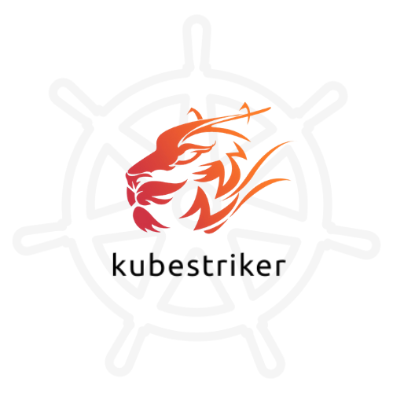

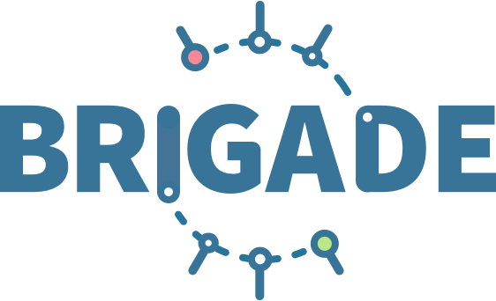
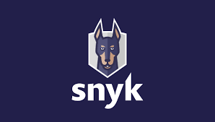
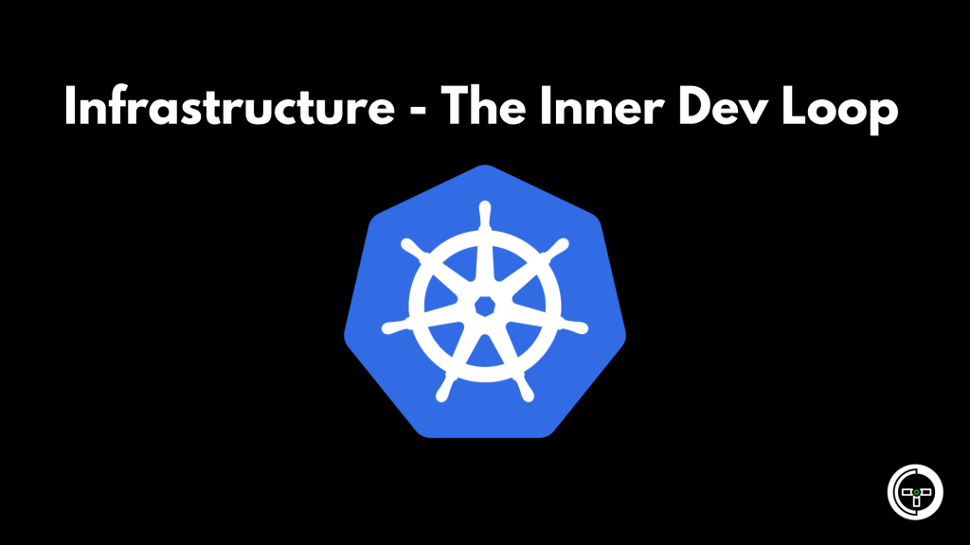
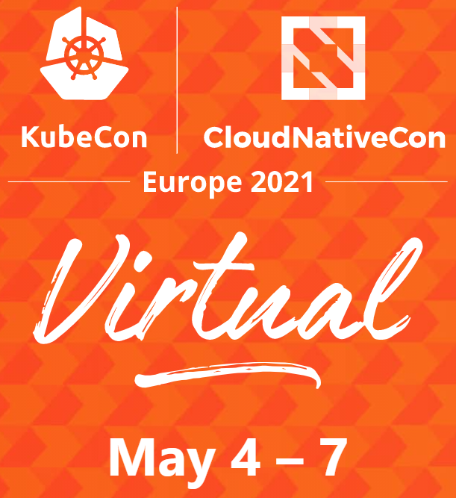
Open Source and Ecosystem call outs
Canary Deployments made easy using Ketch
Deploy & managed K8s apps without Yaml
Meet Brigade 2
Brigade v2.0.0-alpha.1 release
Run scriptable, automated tasks in your cluster
10 Kubernetes Security Context Settings you should understand
Cheatsheet from Snyk
Deep dive into securityContext settings like runAsUser
Kubernetes Infrastructure: Know the Inner Dev Loop
What’s important in inner-loop k8s dev
Tool comparison
Bridge to Kubernetes
$75 for Standard Conference Pass
Keynotes Free of charge
20+ Co-Located Events
Kubestriker performs numerous in depth checks on kubernetes infra to identify the security misconfigurations
Notes:
Ketch "Application delivery framework" - facilitates blue/green, canary deployments using a simple cli https://www.youtube.com/watch?v=SblO7d1TaEk
Ketch is an application delivery framework that facilitates the deployment and management of applications on Kubernetes using a simple command line interface
Meet Brigade 2
Brigade is a tool for running scriptable, automated tasks in the cloud — as part of your Kubernetes cluster.
Unit tests for a Github push
Updating a cosmosDB database
Sending a Slack message
Sending a Twitter DM
10 Kubernetes Security Context Settings you should understand
runAsUser,
Kubernetes Infrastructure: Know the Inner Dev Loop
Tilt, garden, teleprexence, Skaffold and bridge

Slide 9
Dapr on AKS

Slide 10
Microservice development challenges
How do I integrate with external systems that my app has to react and respond to?
How do I create event driven apps which reliably send events from one service to another?
How do I create long running, stateful services that can recover from failures?
How do I observe the calls and events between my services to diagnose issues in production?
How do I access secrets securely from within my application?
How do I discover other services and call methods on them?
How do I secure communication between services?
How do I handle connection failures and build resiliency into my application?
How do I prevent committing to a technology early and have the flexibility to swap out an alternative based on project or environment changes?
How do I write an app that runs in multiple environments without code changes?

Slide 11
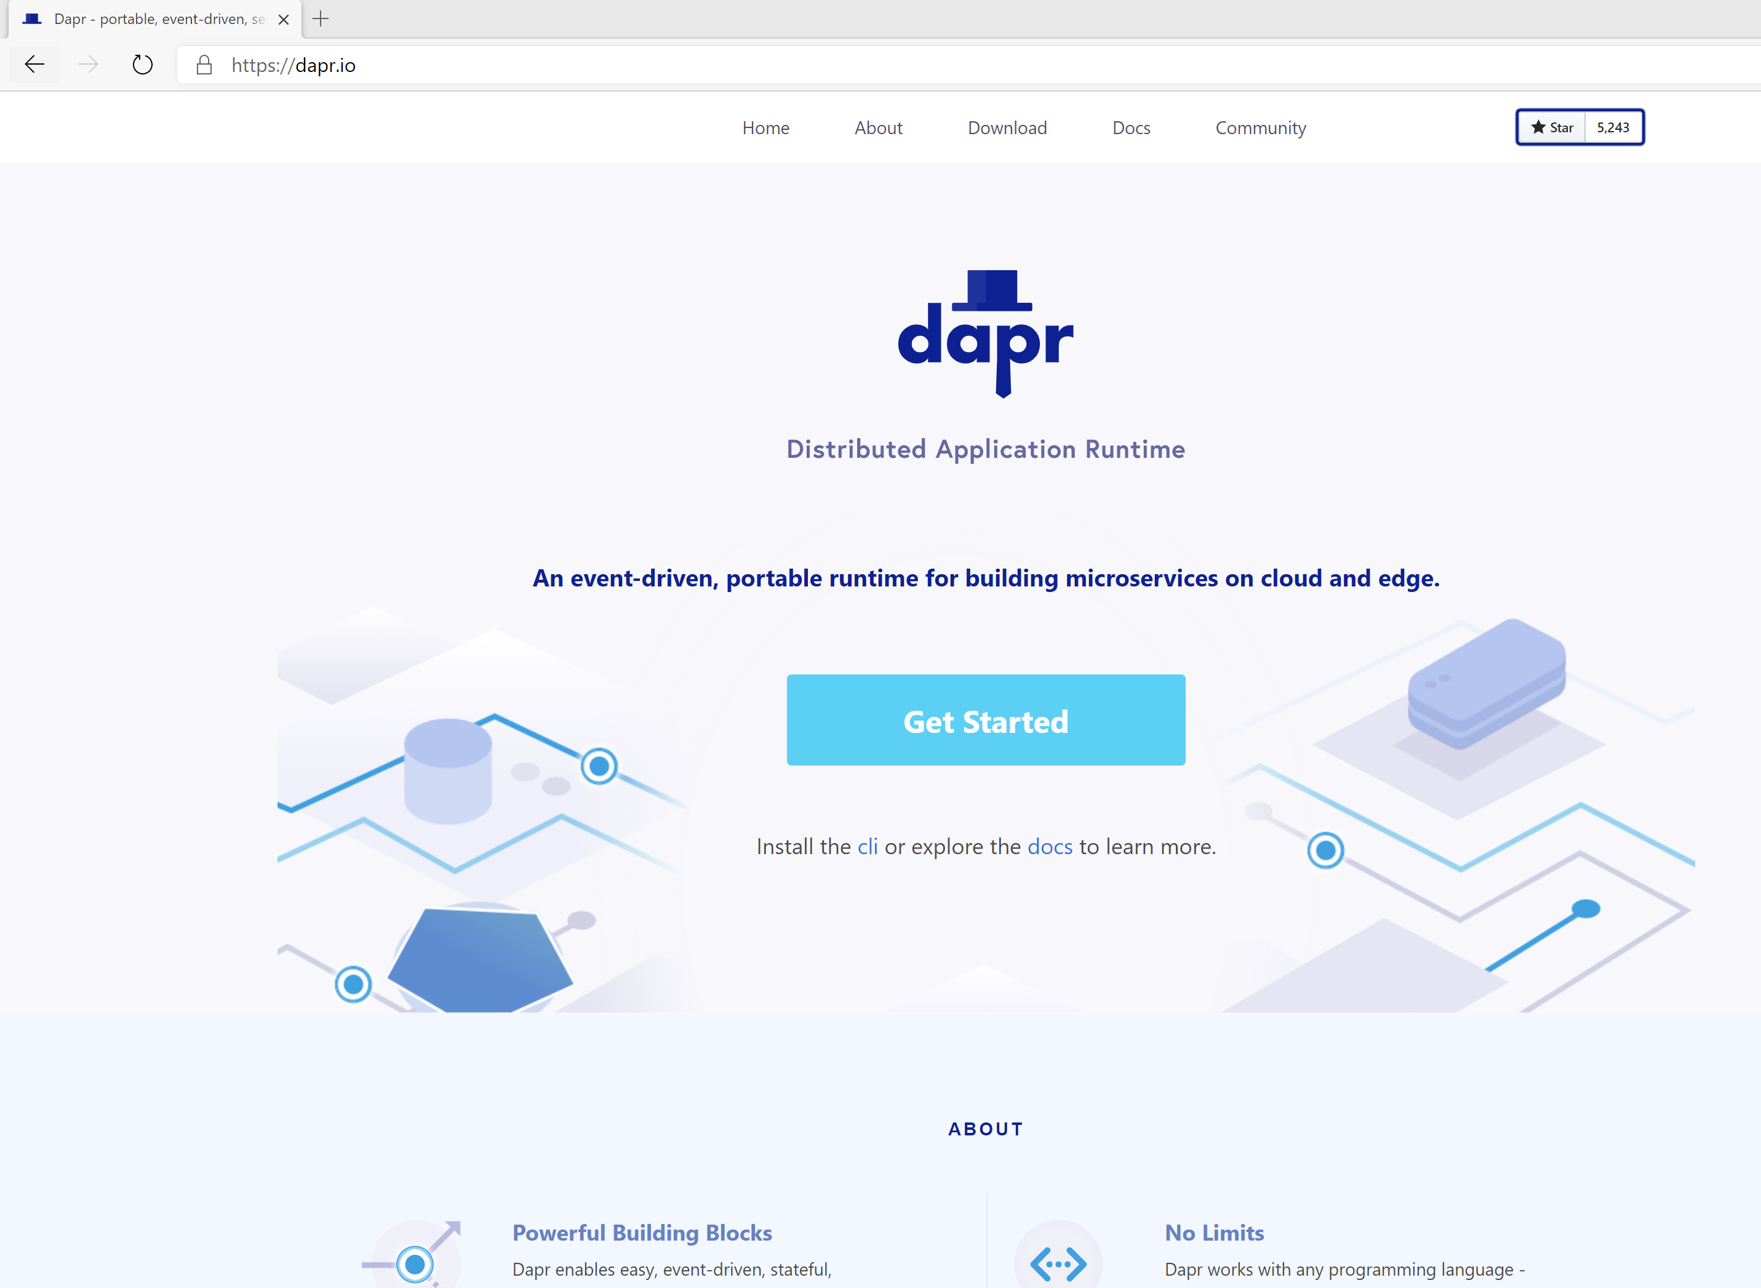

Distributed Application Runtime
Portable, event-driven, runtime for building distributed applications across cloud and edge
https://dapr.io
Notes:
Dapr is a portable, event-driven runtime that makes it easy for developers to build resilient, microservice stateless and stateful applications that run on the cloud and edge and embraces the diversity of languages and developer frameworks.

Slide 12

Dapr Goals
Best-practices building blocks
Any language or framework
Consistent, portable, open APIs
Adopt standards
Extensible and pluggable components
Platform agnostic cloud + edge
Community driven vendor neutral
Notes:
Based on microservices best practices – codifies some of these best practices so that devs can still play with new technologies within some constraints
Any language/framework - dapr provides a set of REST APIs that you can use regardless of what you code in,
Consistent APIs across what is called the dapr building blocks with Opt-in building blocks – only use what pieces you like in dapr, not mandatory to use them all
Adopt OSS/industry standards
Extensible/pluggable – all the dapr components are open source, so you can write your own to integrate into custom systems or extend existing ones
Platform ag – typically has a dependcy on docker but can now be run without docker, as binaries
Community driven and vendor neu – have biweekly community calls, are constantly active in the teams Gitter channel, msft started this but collabing with a ton of other companies/enterprises, gained a lot of traction in the community

Slide 13
Microservice building blocks
Service-to- service invocation
State management
Publish and subscribe
Bindings
(input/output)
Actors
Observability
Secrets
Perform direct, secure, service-to-service method calls
Create long running, stateless and stateful services
Secure, scalable messaging between services
Trigger code through events from a large array of inputs
Input and output bindings to external resources including databases and queues
Encapsulate code and data in reusable actor objects as a common microservices design pattern
See and measure the message calls across components and networked services
Securely access secrets from your application
Notes:
7 main building blocks – opt in
Svc discovery of daprized applications, method calls, including retries, on remote services wherever they are located in the supported hosting environment.’
State –for storing key/value pairs, long running, highly available, stateful services can be easily written alongside stateless services in your application.Lots of components here: cosmos, postgres, blob, redis, mongo, ….
Pub/sub: publishing events and subscribing to topics messaging services: servicebus, kafka, nats, redis, google pubsub
Input and output resource bindings: Resource bindings with triggers builds further on event-driven architectures for scale and resiliency by receiving and sending events to and from any external source such as databases, queues, file systems, etc. – think like Azure functions WRT events driving your other services
Actors: supports the virtual actor model – includes concurrency, state, life-cycle management for actor activation/deactivation and timers and reminders to wake-up actors - need the sdk here if youre planning on using this pattern
Observability - Dapr emit metrics, logs, and traces to debug and monitor both Dapr and user applications , you get for free in all your daprized services, see the data flow through in app insights, or other tracing services that support opentelemtry
Secrets – abstract your secrets from your code using your secret store of your choice – integrates with secret stores in the cloud and locally

Slide 14

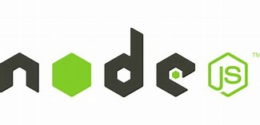



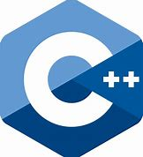

Microservice building blocks
Standard APIs accessed over http/gRPC protocols from user service code
http://localhost:3500/v1.0/invoke/cart/method/neworder
http://localhost:3500/v1.0/state/inventory/item67
Runs as local “side car library” dynamically loaded at runtime for each service
Application code
Microservices written in
Any code or framework…
HTTP API
gRPC API
Service-to-service invocation
State management
Publish and subscribe
Resource bindings and triggers
Actors
Observability
Secrets
Extensible
Notes:
Also are SDKs that you can use in your code if you do not want to call the api calls directly

Slide 15











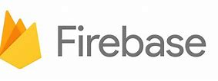



Observability
Sidecars and
components
Capturing, querying
traces, logs and metrics
Prometheus
AppInsightts
Jaeger
Bindings
…others
Scanning for events
Input/output
EventHub
Kafka
AWS SQS
GCP pub/sub
Application
Secure communication with mTLS
Service
code A
Service
code B
Dapr API
Dapr API
Tracing, logs
and metrics
Tracing, logs
and metrics
Sidecar
Sidecar
Load and
save state
State stores
…others
AWS DynamoDB
CosmosDB
Publish & subscribe
Messaging
…others
Service Bus
Notes:
Run dapr alongside your application code: The dapr runtime works by injecting a sidecar process into where your app is running. A sidecar per app instance.
Your app communicates with dapr via a REST api over HTTP or GRPC and allows all tracing, metrics and logs to be collected as the app talks to the sidecar and to other daprized services..
Dapr sidecars communicate with eachother via GRPC and there is an option to enable MTLS across all daprized services
You create these “Dapr Components” that act as interfaces to whatever dapr pieces you want to use – you would create a dapr component for a state store for your app – ie. redis so then dapr would be aware of your state store and you can access it through the state api or though bindings via an skd
Choose resource bindings, state stores and pub sub mechanisms to integrate with as the dapr api (or SDK) with integrate with them directly – meaning you don’t have to import the SDKs into your code of the infra pieces you want to use.

Slide 16
71 Dapr Components
27 I/O Bindings
18 State stores
11 Pub/Sub
13 General
7 Azure
5 AWS
Aerospike
Cassandra
Cloudstate
Couchbase
MySQL
Hashicorp Consul
Hazelcast
Memcached
MongoDB
PostgreSQL
RethinkDB
Redis
Zookeeper
Azure CosmosDB
Azure SQL Server
Azure Table Storage
Azure Blob Storage
Google Cloud Firestore
Redis Streams
Apache Kafka
AWS SNS/SQS
Azure Events Hub
Azure Service Bus
GCP Pub/Sub
Hazelcast
MQTT
NATS streaming
Pulsar
RabbitMQ
APNs
Cron (Scheduler)
HTTP
InfluxDB
Kafka
Kubernetes Events
MQTT
PostgreSql
RabbitMQ
Redis
Twilio
Twitter
SendGrid
Azure Blob Storage
Azure EventHubs
Azure CosmosDB
Azure Service Bus Queues
Azure SignalR
Azure Storage Queues
Azure Event Grid
AWS DynamoDB
AWS S3
AWS SNS
AWS SQS
AWS Kinesis
1 AliCloud
Blob Storage
2 GCP
GCP Cloud Pub/Sub
GCP Storage Bucket
8 Secret stores
Azure Key Vault secret store
Azure Key Vault with Kubernetes MI
AWS Secrets Manager
GCP Secret Manager
HashiCorp Vault
Kubernetes Secrets
Local environment variables (for Development)
Local file (for Development)
4 HTTP Middleware
2 Name Resolution
OAuth2
Open Policy Agent (OPA)
Rate limit
Bearer
Kubernetes
Multicast DNS

Slide 17
Dapr: Technical Details
Written in Go
Runs on Linux, Mac, Windows OS (AMD/ARM architectures)
~23.5Mb image (smaller than Envoy and Linkerd)
< 1% CPU, 4MB physical memory usage
2 CRDs, 4 system pods in Kubernetes (2 are optional)

Slide 18


Microservice building blocks
Publish and subscribe
Publish
Subscribe
“cart”
Get
http://localhost:8004/dapr/subscribe
http://localhost:8005/dapr/subscribe
[ {
"pubsubname":"<pubsub-name>",
"topic":"order",
"route":"/order"
} ]
Post
http://localhost:8004/order
Post
http://localhost:3500/v1.0/publish/<pubsub-name>/order
“shipping”
{
"user":"johndoe",
"item":"ZeroDay"
}
"data": {
"user":"johndoe",
"item":"ZeroDay"
}
Post
http://localhost:8005/order
“email”
Notes:
The publish/subscribe pattern allows microservices to communicate with each other using messages. The producer sends messages to a topic without knowledge of what application will receive them. Similarly, a consumer will subscribe to the topic and receive its messages without any knowledge of what application produced these messages. This pattern is especially useful when you need to decouple microservices from one another.
To enable message routing and to provide additional context with each message Dapr uses the CloudEvents 1.0 specification as its message format. Any message sent by an application to a topic using Dapr will automatically be “wrapped” in Cloud Events envelope
Dapr allows two methods by which you can subscribe to topics: declarative, where a subscription is defined in an external file, and programmatic, where a subscription is defined in the user code. For more information see Dapr’s documentation on subscribing to a topic.

Slide 19
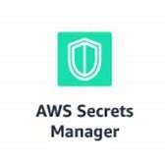




Cloud Secret Stores
Microservice building blocks
Secrets
Google
Key Management
Azure
Key Vault
Application
code
GET
http://localhost:3500/v1.0/secrets/vault/my-secret
my-secret “supersecret”
Notes:
Connection strings, keys and tokens that are used to authenticate with databases, services and external systems in secrets by using a dedicated secret store.
Usually this involves setting up a secret store such as Azure Key Vault, Hashicorp Vault and others and storing the application level secrets there. To access these secret stores, the application needs to import the secret store SDK, and use it to access the secrets. This may require a fair amount of boilerplate code that is not related to the actual business domain of the app, and so becomes an even greater challenge in multi-cloud scenarios where different vendor specific secret stores may be used.
Using Dapr’s secret store building block typically involves the following:
Setting up a component for a specific secret store solution.
Retrieving secrets using the Dapr secrets API in the application code.
Optionally, referencing secrets in Dapr component files.
In Azure Dapr can be configured to use Managed Identities to authenticate with Azure Key Vault in order to retrieve secrets. an Azure Kubernetes Service (AKS) cluster is configured to use managed identities. Then Dapr uses pod identities to retrieve secrets from Azure Key Vault on behalf of the application.

Slide 20






Kubernetes hosted Dapr control plane
Identity control plane for distributed systems
X.509 cert
Deploys and manages Dapr
1
Components
Updates actor partition placement
Injects Dapr runtime
Certificate Authority
Update component changes
Bindings
Pod
Pod
Pod
Pod
Input/output
CONTAINER
CONTAINER
CONTAINER
CONTAINER
…others
Component management
EventHub
Kafka
AWS SQS
GCP pub/sub
Actor Placement
Sidecar Injector
Sentry
CA and Identity
Operator
State stores
…others
Secure with mTLS
to/from sidecar
Pod
AWS
DynamoDB
CosmosDB
Pod
CONTAINER
Dapr API
CONTAINER
Publish & subscribe
Readiness and Liveness probe on healthz API to determine Dapr health state
Kubelet
…others
HTTP or gRPC
Sidecar
Application code
Service Bus
Observability
Use components
Any cloud or edge infrastructure
Prometheus
AppInsightts
Jaeger
Notes:
dapr-operator: Manages component updates and Kubernetes services endpoints for Dapr (state stores, pub/subs, etc.)
dapr-sidecar-injector: Injects Dapr into annotated deployment pods
dapr-placement: Used for actors only. Creates mapping tables that map actor instances to pods
dapr-sentry: Manages mTLS between services and acts as a certificate authority

Slide 21




Dapr Security in Production on Kubernetes
1
state store
pub/sub
Actor Placement
Sidecar Injector
Sentry
CA and Identity
Operator
namespace: dapr-system
namespace: redis
mTLS
mTLS
ACL
ACL
SSL
Ingress
app1p1
app2p1
ACL
app3p1
ACL
secrets
namespace: default
namespace: A
namespace: B
Secret stores
identity control plane for distributed systems
X.509 cert
GCP
Secret Manager/KMS
Azure
Key Vault
Notes:
One of the features released recently was the capability for ACLs – these restrict what operations calling applications can perform, via service invocation, on the called application

Slide 22
Secure ingress communication
Daprize proxy servers
Ingress
App
Secure communication with mTLS
Service
code
Dapr
API
Service
code
Service
code
Dapr
API
Identity control plane for distributed systems
X.509 cert

Slide 23

Daprized Ingress with Kubernetes
1
Actor Placement
Sidecar Injector
Sentry
CA and Identity
Operator
namespace: dapr-system
mTLS
mTLS
SSL
Ingress
App1
App2p1
namespace: default
namespace: A
namespace: B
Identity control plane for distributed systems
X.509 cert

Slide 24


Dapr and Service Meshes
Application code
Microservices written in
Any code or framework…
Developer
HTTP API
gRPC API
Service-to- service invocation
State management
Publish and subscribe
Secrets
Resource bindings and triggers
Actors
mTLS
Metrics
Resiliency
Distributed tracing
Service
Mesh
Traffic routing
Traffic splitting
Operator
Hosting Infrastructure

Slide 25


Dapr v1.0 released on Feb 17th 2021!

Slide 26

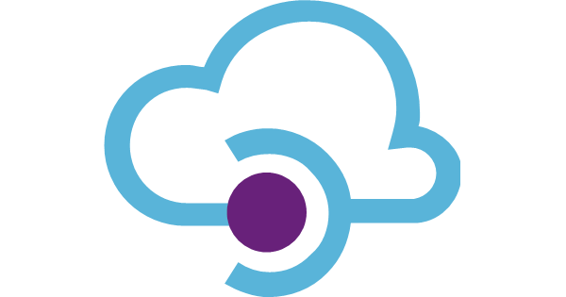


Dapr 2020 Highlights
Milestones
Released Oct 2019
13 total releases (10 during 2020)
2 release candidates for v1.0
Release candidate 3 coming this week
On track for v1.0
Hundreds of outreach activities
Community articles, blog posts, workshops, presentations, and books
Integrations
New websites
Components
Community
Contributors
Community
Opened PRs
Establishing an open governance framework
Logic Apps
20 → 71
214 → 625
207 → 849
docs.dapr.io
API Management
GitHub stars
Twitter
Followers
Community
Calls
Image Pulls
Functions
4k → 8.8k
blog.dapr.io
0.5k → 4.5k
24
15M+

Slide 27
Dapr v1.0 Production Readiness
Observability for logs, metrics and tracing
High availability and upgrades
Dapr Control plane services run with multiple instances
Dapr CLI provides safe, controlled installation and upgrades for Dapr runtime
Scale/Performance
Dapr Service invocation performance | Dapr Docs numbers
Dapr tested to run hundreds of thousands of concurrent actors at scale
Component certification
API certification conformance testing
Subset of components certified that are being used in production by at least two customers
Versioning and compatibility
Component and API versioning enables side-by-side usage of multiple versions
Backwards compatibility between releases with deprecation policies
Hot fixes/patching for current (n) and previous releases (n-1)
Testing
End-to-End Testing harness for integration scenarios
Long-Haul testing harness for memory leaks, retry failures, etc
Performance testing
Security across the board
Access control
Identity and encryption
Component, secret, operation and message scoping
Notes:
Observability to diagnose issues
Dapr Logs to diagnostic app issues
Dapr metrics for performance
Dapr tracing to diagnostic calls time, call failure and display application maps
Security across the board
Undergone a security audits from Cure53, a CNCF approved cybersecurity firm
Cross-namespace service invocation with logical domain groups and trust relationship management
Secure microservice communication using mTLS and SPIFFE identity verification
Per operation verb access control settings (for example deny all except POST from app2 on /op1)
Per application component scoping (which app should be able to access a given component)
Pub/Sub topic scoping (which app should be able to publish or subscriber to a given topic)
Application-level secret access control (which secrets the app should be able to access)
High availability and upgrades
Dapr Control plane services run with multiple instances
Dapr CLI provides safe, controlled upgrades for Dapr runtime
Component versioning enables side-by-side usage of multiple versions
Scale/Performance
Dapr Service invocation performance | Dapr Docs numbers
Dapr tested to run hundreds of thousands of concurrent actors at scale
Component certification
API certification conformance testing
Subset of components certified that are being used in production by at least two customers
Versioning and compatibility
Component and API versioning
Backwards compatibility between releases with deprecation policies
Hot fixes/patching for current (n) and previous releases (n-1)
Testing
End-to-End Testing harness for integration scenarios
Long-Haul testing harness for memory leaks, retry failures, etc
Performance testing

Slide 28
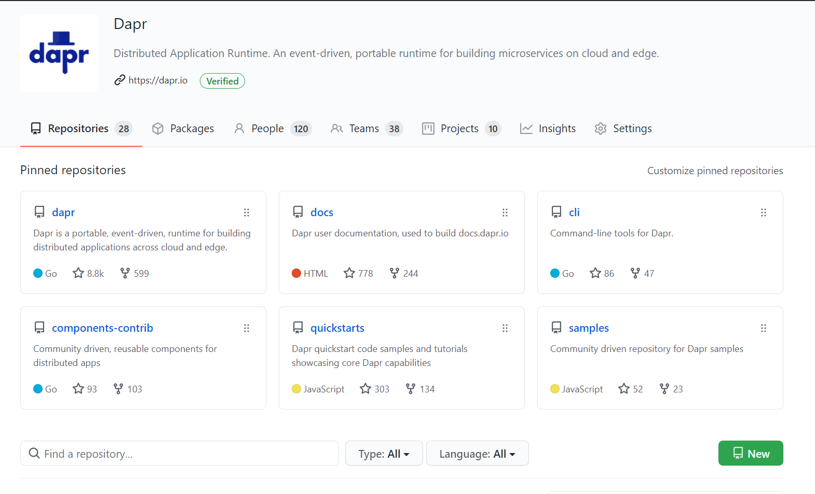
Dapr OSS Roadmap - Driven by the community- https://github.com/dapr
Feature enhancements to existing building blocks
Query in state management
Topic filtering in pub/sub
App tracing API in observability
Binding and pub/sub support in actors, self deletion of actors
Additional building blocks
Configuration API
Http scale-to-zero autoscaler
Leader election building block for singleton instances
Transparent proxying for service invocation
Resilience (circuit breakers, Bulkhead, Timeout)
Integration with frameworks & cloud native technologies
e.g. Django, Micro, Nodejs, Express, Kyma, Midway
Additional “crafted” language SDKs
Javascript , RUST, C++, …
Additional hosting platforms
VMs, IoT Edge, Azure Stack Edge, Service Fabric
Productive developer and operator Tooling
VS Code extension, Remote Dev Containers, Enhancement to Dapr operational Dashboard
Fundamentals
Security, performance, scale, conformance testing, automation, load-testing, E2E testing, chaos testing
Audit from CNCF approved security company – Cure53

Slide 29
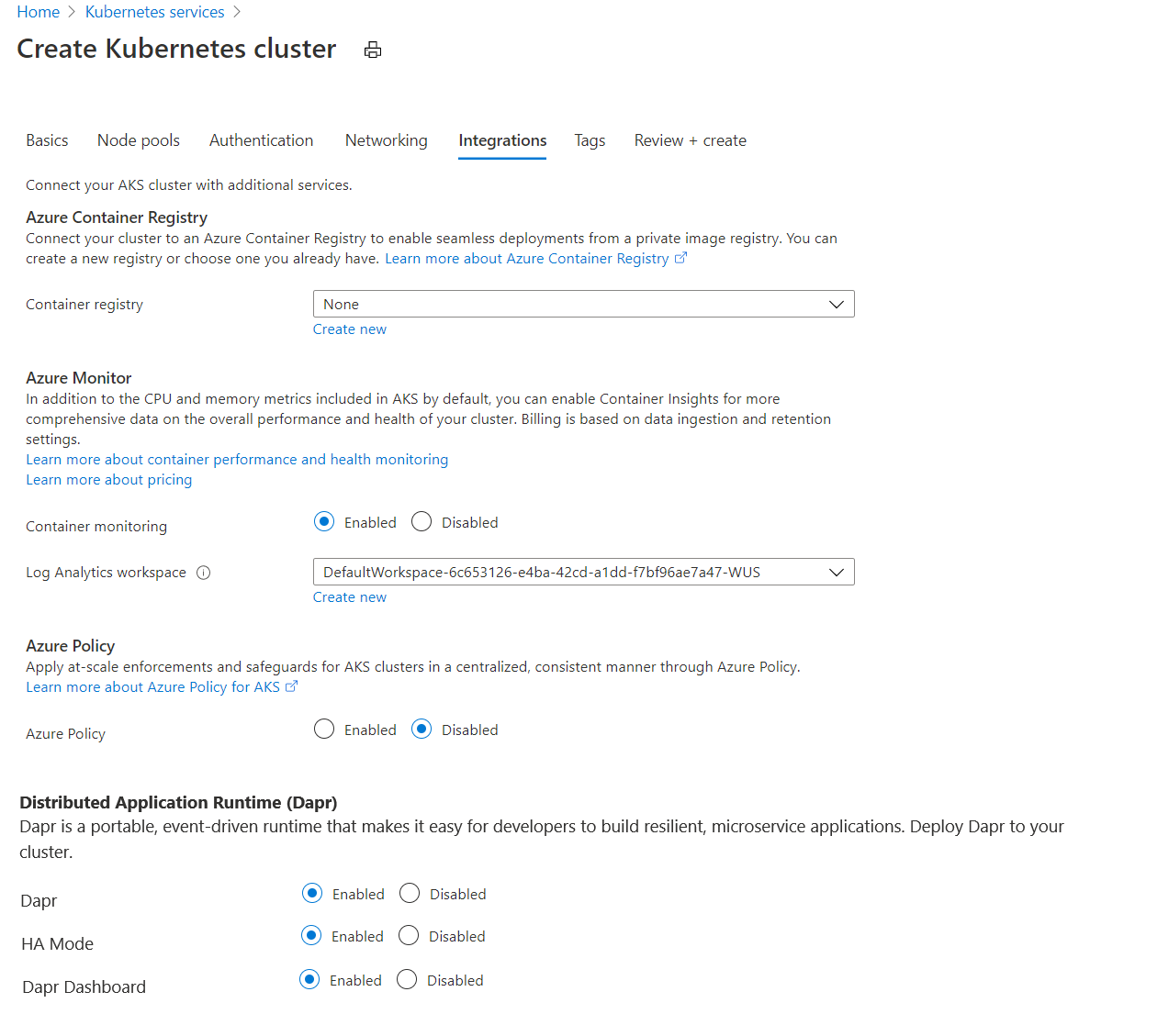
Dapr & Azure: AKS Addon
Dapr CLI is easy today
dapr init -k
dapr upgrade -k --runtime-version=1.0.0
dapr dashboard -k
Dapr AKS Addon even easier
Dapr is a supported Addon
Will include integration with Azure Monitor
MICROSOFT INTERNAL

